Slide 1
Pietas in Vergil’s Aeneid
Dr. Alan Haffa
Please Silence Cell Phones

Slide 2
Adopt and Adapt
Vergil adopts and adapts both Homer’s Iliad and Odyssey
First six books are an Odyssey and last six an Iliad
Aeneas as an Achilles, who is more loyal to his comrades in war, and an Odysseus, who is trustworthy and who sacrifices for something greater than himself—his family and people.

Slide 3
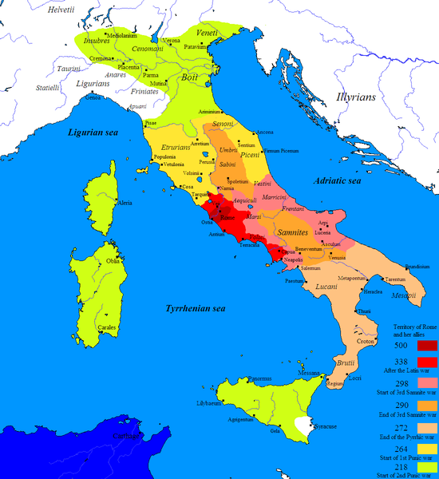
The Aeneid as a Myth of Roman Origins
Explain the origins of the Romans
Explain the conflict with the Greeks and show Roman superiority
Explain the conflict with the Carthaginians
Divine Origins of Julius Caesar’s family (Venus as mother of Aeneas)

Slide 4
Offer a mythic resolution of Roman Civil conflict
Heterogeneous origins of Romans (Trojan; Etruscan; Greek; Latin)
Offer a mythic analogy to Roman Civil Wars
Explain why Latin is the language of Romans
Explain divine plan, which legitimates Rome as world conqueror
Provide a moral foundation for this Empire: Pietas
Praise Roman Empire under Augustus—from the origins of Rome the gods intended Rome and Augustus’ rule

Slide 5
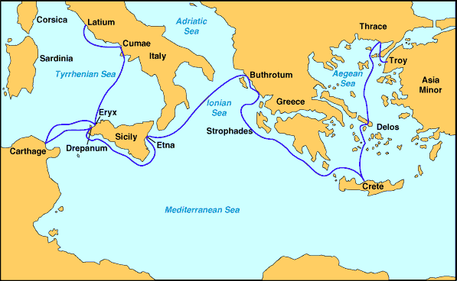
Book 3: Aeneas’ Odyssey

Slide 6
Journey and Sacrifice
Wife: Creusa lost in escape from Troy
Ghost of Polydorus, Slain by Thracians; Dante (Broken branch and blood)
Women who burn ships in Sicily, abandoned
Dido, who commits suicide
Father Anchises, who dies
Palinurus falls off ship as it sail to Italy from Siciliy

Slide 7
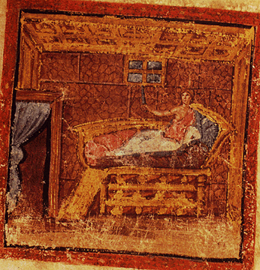
Tragedy of Dido
Juno and Venus Plot a “Wedding”
Jove, Mercury: “Leave for the future of your son” Pietas
Dido’s Supplication; Aeneas’ Answer: No marriage; Love of Country and Son and Father Urge him On
“I sail for Italy not of my own free will”

Slide 8
Curse of Dido and the Madness of Women
Madness (Furentem: Same adjective that described her when she fell in love) of Dido: Resolves to commit Suicide
Makes a shrine of their bed with his clothes: Immolates herself on it
“If he must find a haven…let him see the unmerited deaths of those around him, and accepting peace on unjust terms…let him fall in battle, unable to enjoy his new kingdom…O my Tyrians, besiege with hate his progeny and all his race to come…No love, no pact between our peoples”

Slide 9
Interpretation
Metaphors convey psychology of Madness and Despair: flames and madness and Furies; She represents Passion opposed to Reason
Despite her madness, she is painted more sympathetically than the Greeks and Ulysses; Perhaps the legacy of the Greeks was a greater threat to Roman Pride than the memories of the Carthaginian Empire

Slide 10
Descent to Hades
Epic Tradition and Praise of Augustus
Sees the Future of Rome: Romulus, “Caesar, and all the line of Iulus”; “this is the man, this one, of whom so often you have heard the promise, Caesar Augustus, son of the deified, who shall bring once again an age of Gold…”
Clouds of Civil War: Brutus, who slew his sons
“You must not blind your hearts to that enormity of civil war, turning against your country’s very heart…”
Artes Romani: “to pacify, to impose the rule of law, to spare the conquered, battle down the proud.”
Laments the death of Marcellus, son of Augustus who died

Slide 11
Shield of Aeneas
Arms for Aeneas (like Achilles); Various Roman Legends depicted; Actium Described; “Antoninus with barbaric wealth and a diversity of arms…leading the powers of the East, of Egypt, even of distant Bactra…And in his wake the Egyptian consort came so Shamefully…”
Barbaric Gods of East pitted against Roman Gods
“Miratur rerumque ignarus imagine gaudet” He marveled and ignorant of the events, he rejoiced in the pictures” Does his lack of understanding cloud the political message?

Slide 12
War between Latins and Romans: Pietas and Supplication
War with Latins over Latin princess, Lavinia
Trojans and Arcadian Greeks versus Latins and Etruscans
Turnus (Latin leader) poetically styled after Achilles
Aeneas rages like Achilles, denying supplications, until he finally shows pity for Lausus due to Pietas
But unlike Achilles, poem ends with vengeful death of Turnus. Why?

Slide 13
Supplication of Magus
“I pray you by your father’s ghost and by your hope of Iulus’ rising power, preserve a life here, for a father and a son. I have a great house. Hidden deep within are bars of enchased silver, weights of gold both finished and unfinished. Victory for Trojans cannot hinge on this one case; this one life cannot weigh so much.”
Aeneas: “Those bars of gold and silver that you tell of, spare for your sons. Turnus has already done away with such war-trade, Pallas being lost. My father Anchises’ ghost feels as I say, and so does Iulus.”

Slide 14
Mezentius and Lausus
Sacrifice of son for father reawakens Aeneas’ Pietas
“O poor young soldier, how will Aeneas reward your splendid fight? How honor you, in keeping with your nature? Keep the arms you loved to use, for I return you to your forebears, ash and shades, if this concerns you now. Unlucky boy, one consolation for sad death is this: you die by the sword thrust of great Aeneas.”
He lifts the body (Achilles) and hands it over for burial with the Armor

Slide 15
Supplication and Death of Turnus
Appeal by Father
Aeneas undecided; Sees Pallas’ Belt and is enraged: “This wound will come from Pallas: Pallas makes this offering and from your criminal blood exacts his due.” Turnus’s spirit, indignata, groans and flees to the underworld.
Lack of Resolution calls into question Pax Romana

Slide 16
Conclusion
Propaganda: End of Civil Wars; Unification of Italian Peoples into Roman; Caesar Deified; Antony and Cleopatra (Dido) vilified
Aeneas represents Roman Virtues: Steadfast, Courageous, Dutiful, Pious, Warlike, Just, Loyal,
Anchises’ admonition: “Spare the Conquered, War down the Proud”
Reputed Mercy of Julius Caesar

